Slide 1


Exploring Myeloid Stem Cell Differentiation Pathways
Ashley, Chase, Christian, Mariana, Paula
Group 11

Slide 2
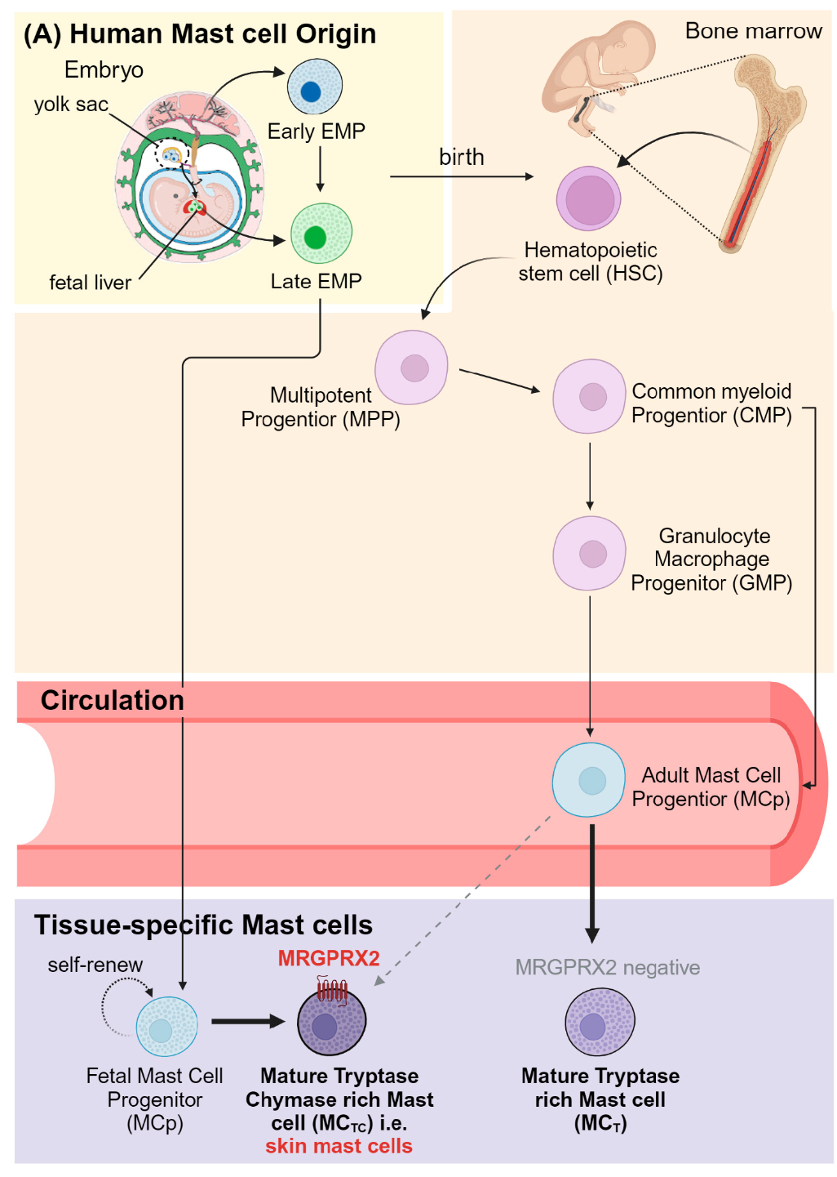
Background: Mast Cell Development
Bosveld, Guth, & Pundir., Cells 2023
Notes:
Bosveld, C. J., Guth, C., Limjunyawong, N., & Pundir, P. (2023). Emerging Role of the Mast Cell-Microbiota Crosstalk in Cutaneous Homeostasis and Immunity. Cells, 12(22), 2624. https://doi.org/10.3390/cells12222624
Drissen, R., Thongjuea, S., Theilgaard-Mönch, K., & Nerlov, C. (2019). Identification of two distinct pathways of human myelopoiesis. Science immunology, 4(35), eaau7148. https://doi.org/10.1126/sciimmunol.aau7148 (right)

Slide 3
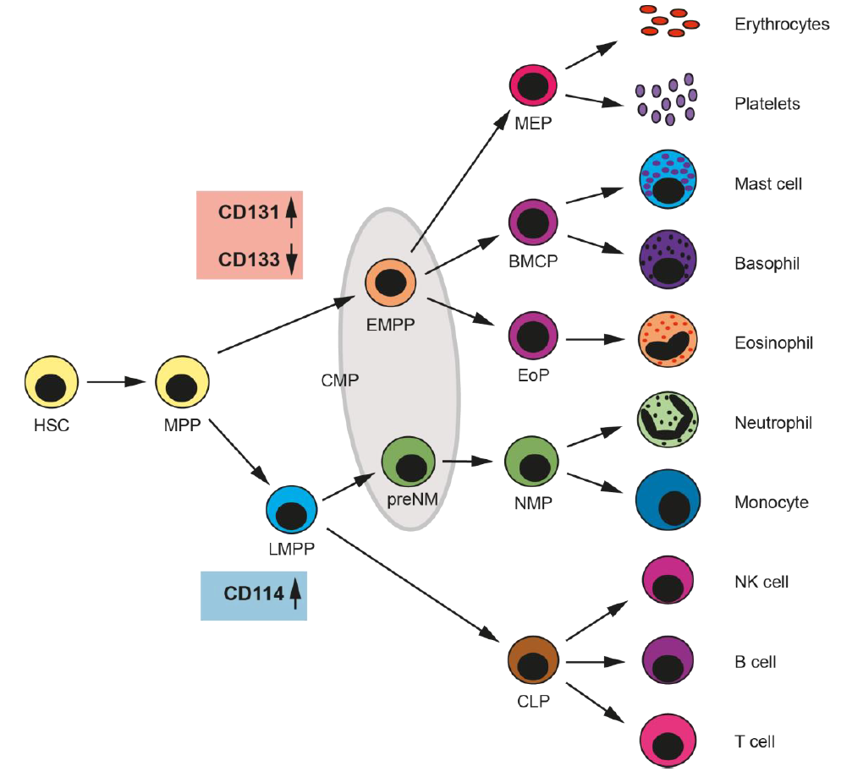
Background: Mast Cell Development
Bosveld, Guth, & Pundir., Cells 2023
Drissen, et al., Science immunology 2019
Notes:
Bosveld, C. J., Guth, C., Limjunyawong, N., & Pundir, P. (2023). Emerging Role of the Mast Cell-Microbiota Crosstalk in Cutaneous Homeostasis and Immunity. Cells, 12(22), 2624. https://doi.org/10.3390/cells12222624
Drissen, R., Thongjuea, S., Theilgaard-Mönch, K., & Nerlov, C. (2019). Identification of two distinct pathways of human myelopoiesis. Science immunology, 4(35), eaau7148. https://doi.org/10.1126/sciimmunol.aau7148 (right)

Slide 4
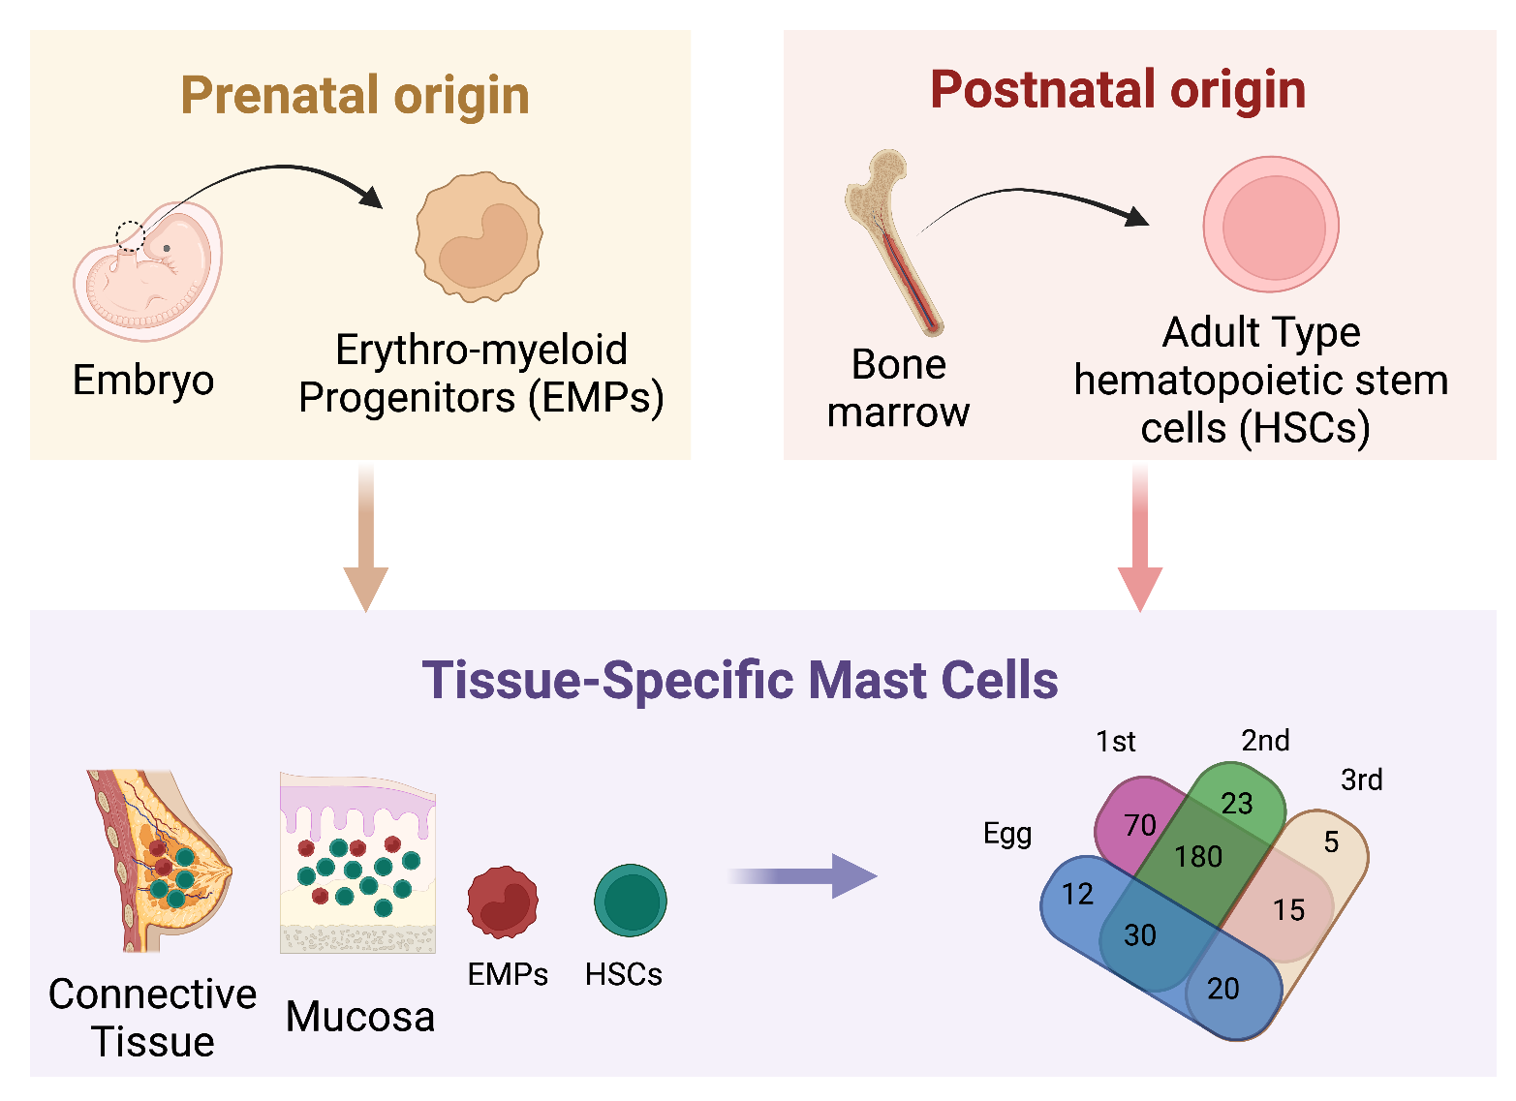
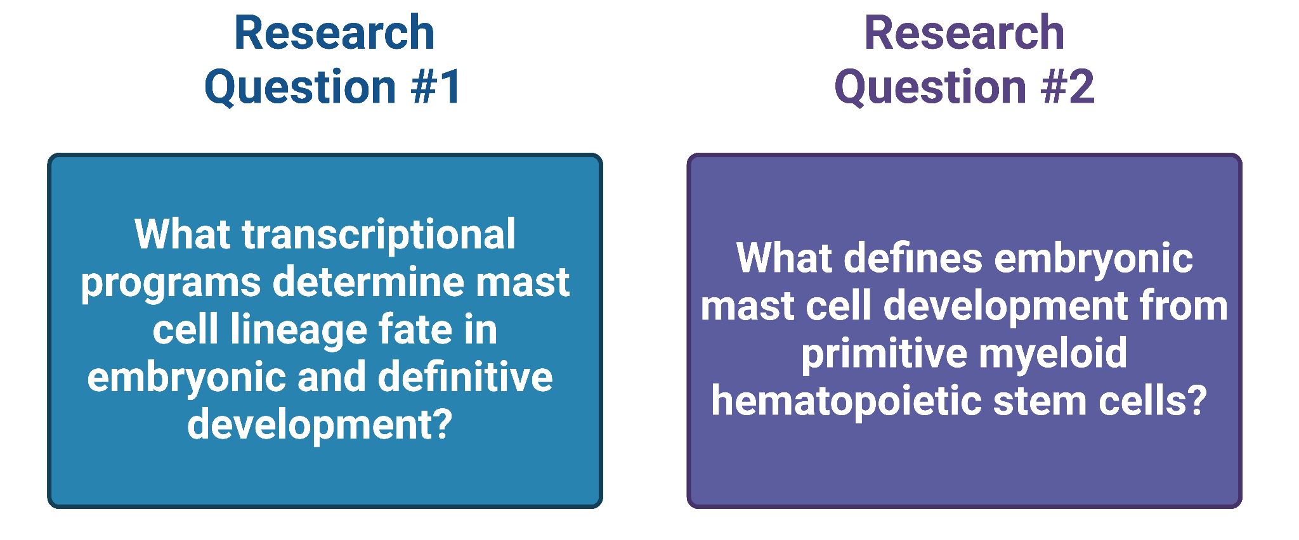
Project Goals
Hypothesis
Created on BioRender
Notes:
Hypothesis: Embryonic and definitive mast cells originating from distinct, lineage-specific progenitor popula- tions rely on different transcriptional programs to determine mast cell fate during development.
1. What are the transcriptional programs that determine mast cell lineage fate in both embryonic and definitive development?
(a) Our group will identify Differentially Expressed Genes (DEGs) related to transcriptional control/cell fate between embryonic and definitive mast cells.
(b) We will use these DEGs to perform Gene Set Enrichment Analysis to determine if there are functional differences between definitive and embryonic mast cells.
2. What defines embryonic mast cell development from primitive myeloid hematopoietic stem cells?
(a) We will perform pseudotime trajectory analysis using Monocole 3 to determine a differentiation trajec- tories for mast cell populations originating from primitive hematopoetic stem cells.

Slide 5
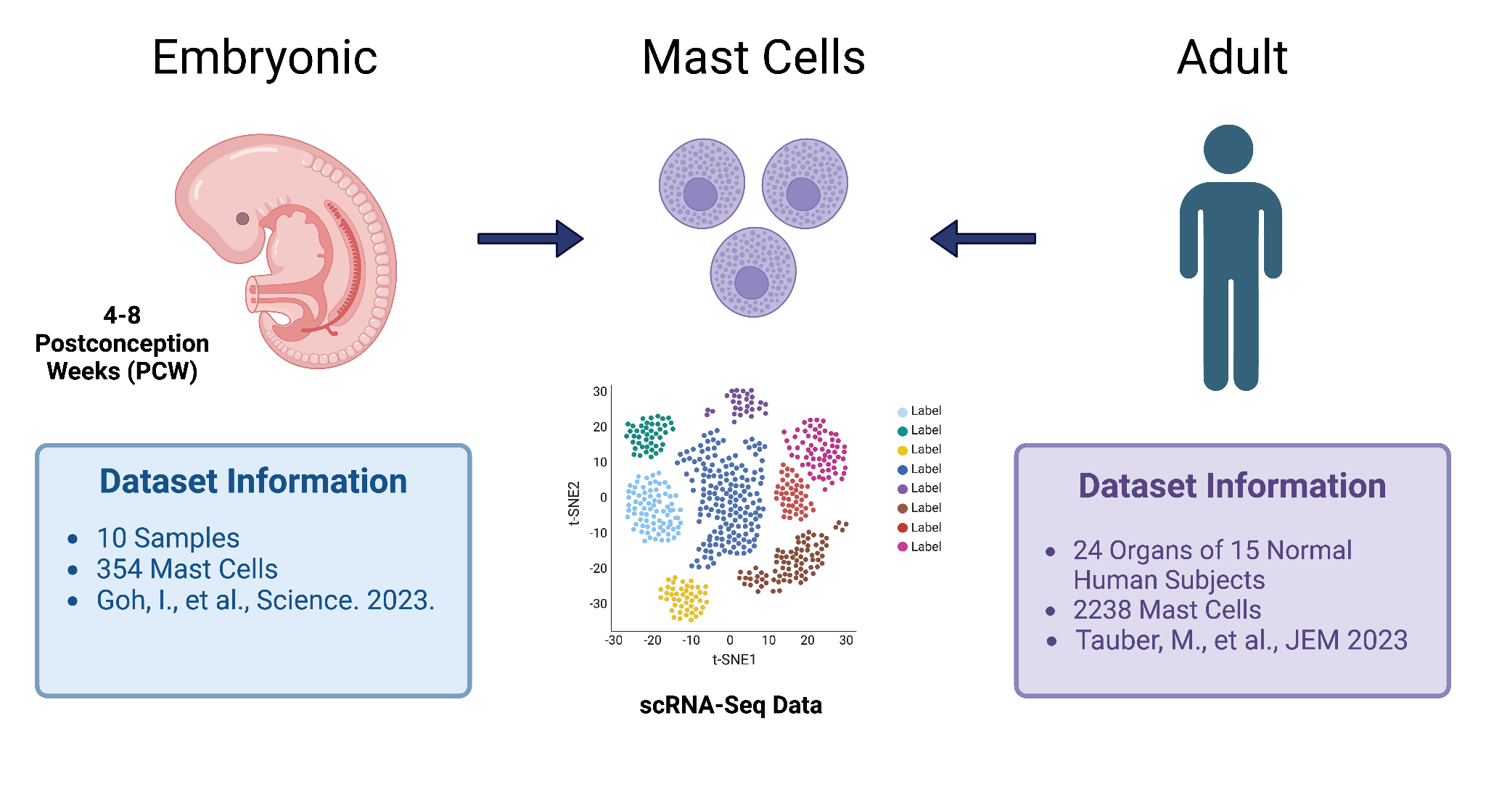
Data Overview
h5ad
Seurat
h5ad
Created on BioRender
Notes:
To test the hypothesis (that whether mast cells came from different lineages), we need two datasets, one for embryonic and one for adult. Both are scRNA-seq collected by 10x Genomics using both 3’ and 5’ assays. Start with the embryonic cells dataset, these are human yolk sac data points collected from 4-9 postconception weeks, the original dataset contains hundred thousands data points from different hematopoietic cells with specific cellular subtypes. For us, we only want to analyze myeloid mast cells, thus we narrowed the sample down to a total number of 354. It contains 10 samples, with 126 females and 228 males sample.
Similarly, the original human dataset is also huge. We narrowed it down to contain data points that are only relevant to mast cells. This gave us 2238 cells. Both datasets contains similar numbers of male and female donors. We then can move on to the analysis outlines that we prepare to pursue.
We might have to address the issue of uneven distribution of the two datasets?

Slide 6
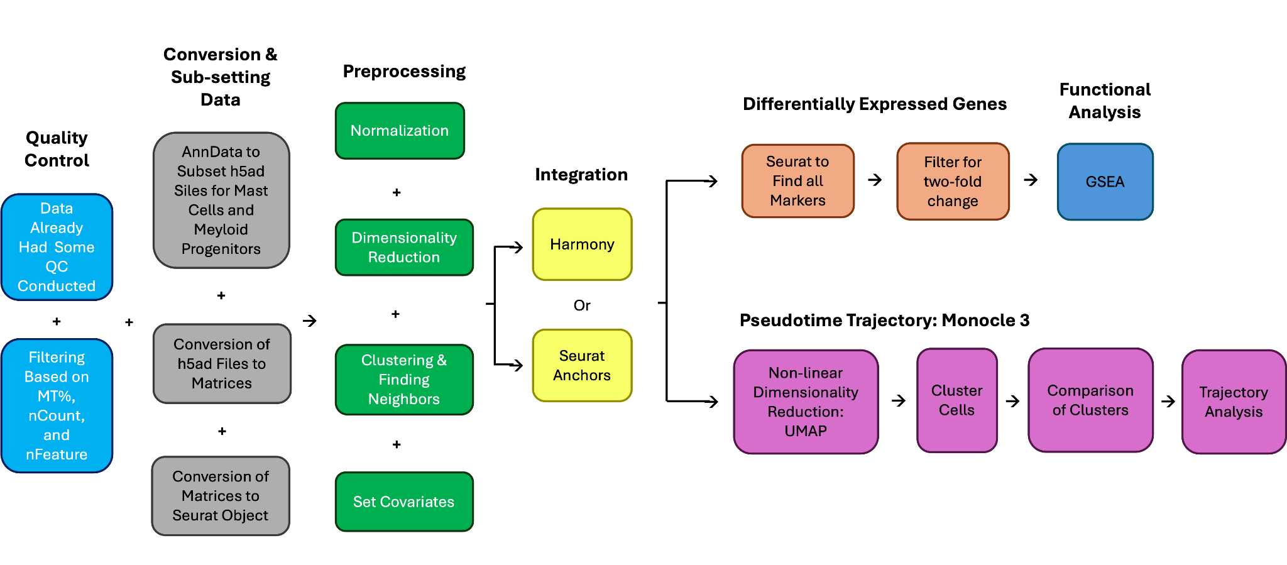
Analysis Workflow

Slide 7
Analysis Workflow
Purpose: To Study Differences in DEGs Between Adult and Embryonic Mast Cells

Slide 8
Analysis Workflow
Purpose: To Study Differences in DEGs Between Adult and Embryonic Mast Cells
Purpose: To Study Pathways and Trajectories in Hematopoiesis Related to Mast Cells

Slide 9
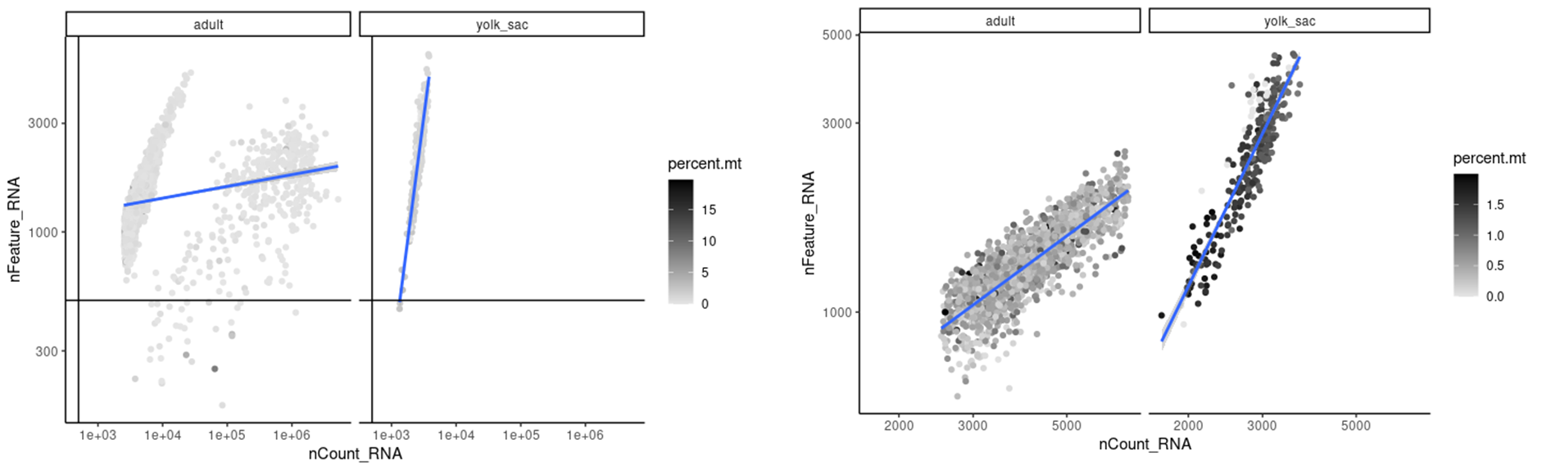
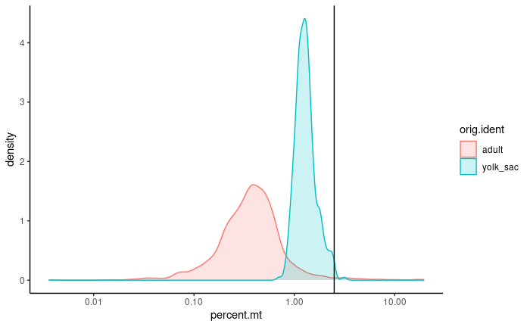
Pre-processing

Slide 10
Pre-processing
<2~ % Mitochondrial reads & <7000 Counts.

Slide 11
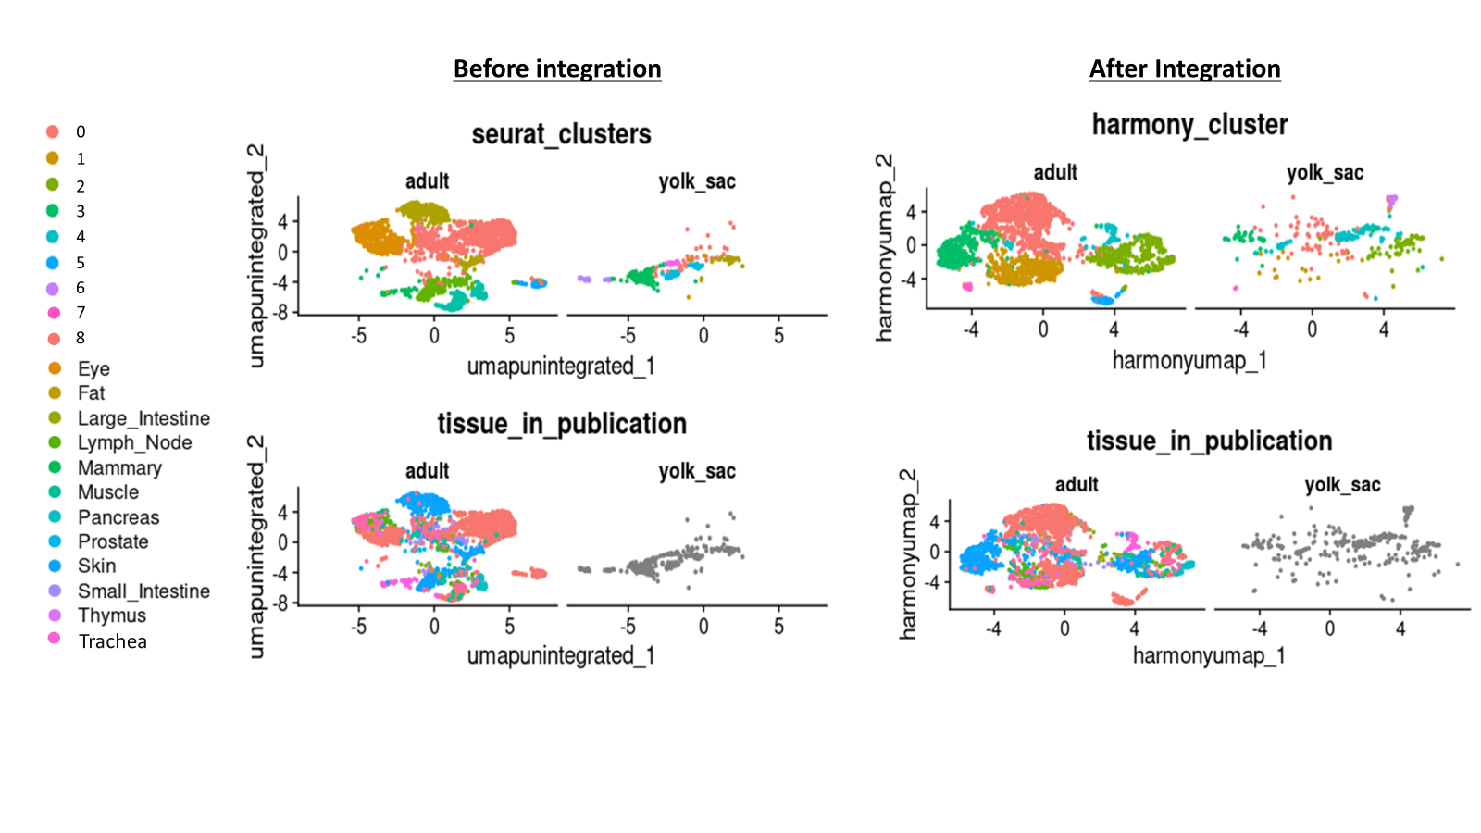
Normalization, Integration, and Clustering..
Iterated through several ways of integration…
We probably could have done our whole project on this step alone for these datasets

Slide 12
Clustering

Slide 13
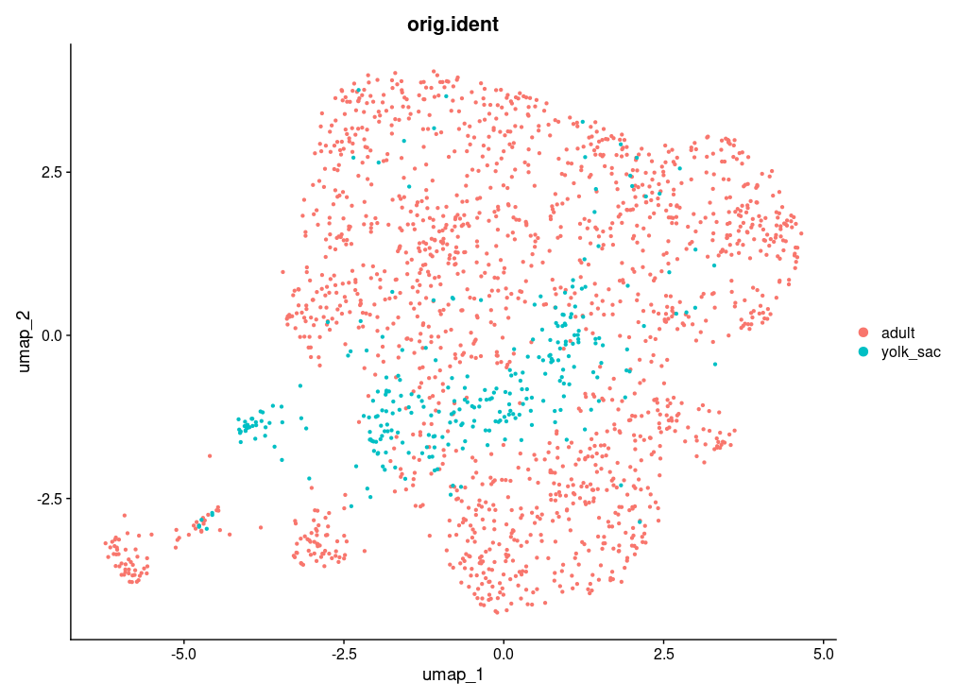
Clustering

Slide 14
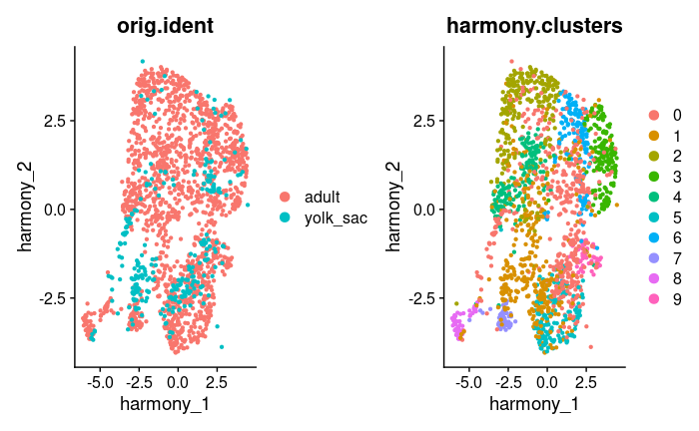
Clustering

Slide 15
Clustering

Slide 16
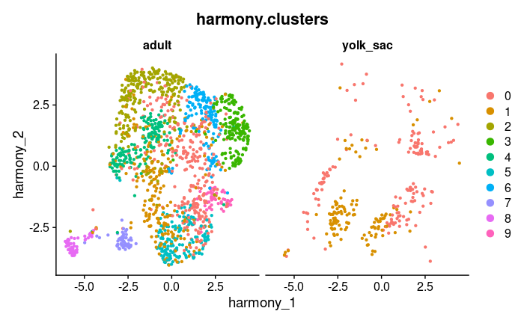
Clustering

Slide 17
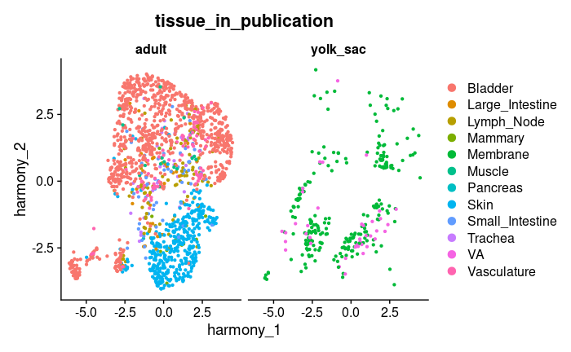
Clustering

Slide 18
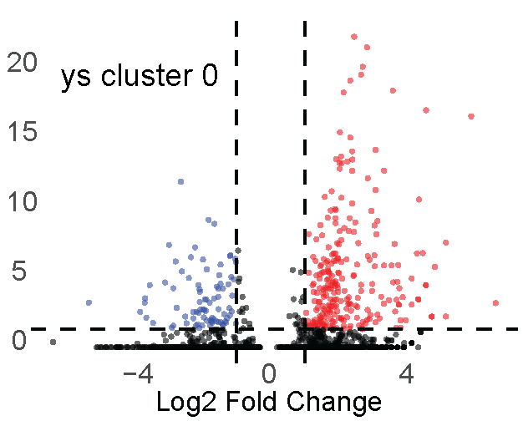
Yolk Sac Cluster 0
Yolk sac cells from cluster 0 compared against all other cells
GO terms | TFs
Catalytic complex Vesicle-mediated transport Microtubule cytoskeleton Endosome Protein DNA complex organization Mitochondrion Vesicle membrane Post-translational protein modification Establishment of protein localization Nuclear protein containing complex | DIDO1 ELF2 SUPT20H ZNF711 SKIL ATF6 CEBPZ DACH1

Slide 19
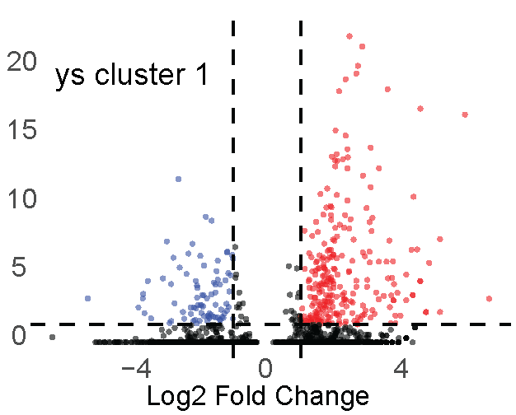
Yolk Sac Cluster 1
Yolk sac cells from cluster 1 compared against all other cells
GO terms | TFs
Mitochondrion DNA metabolic processes Catalytic complex Nuclear protein containing complex Protein DNA complex organization Envelope Organelle inner membrane Chromosome Chromatin remodeling Mitochondrial envelope | SUPT20H DIDO1 SKIL ZNF711 ADA2 BRCA2 SETD1A ZNF407 SALL4 ZFHX3

Slide 20
Transcriptional regulators
Supt20H: regulation of transcription by RNA polymerase 2
DIDO1 (Death-inducer obliterator): Promotes embryonic stem cell self-renewal
ADA2: growth factor
Yolk Sac Cluster 0
Yolk Sac Cluster 1
Supt20H
DIDO1
Protein DNA Complex Org.
Cell transport GO terms
Structural GO terms

Slide 21
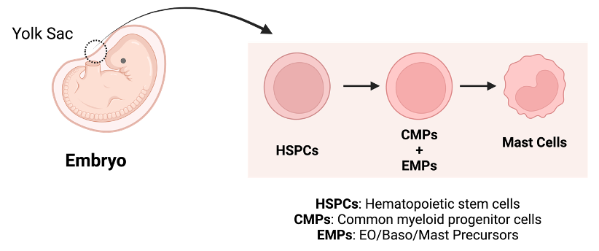
Embryonic Yolk Sac Data Annotation For Pseuodotime Trajectory
Created on BioRender

Slide 22
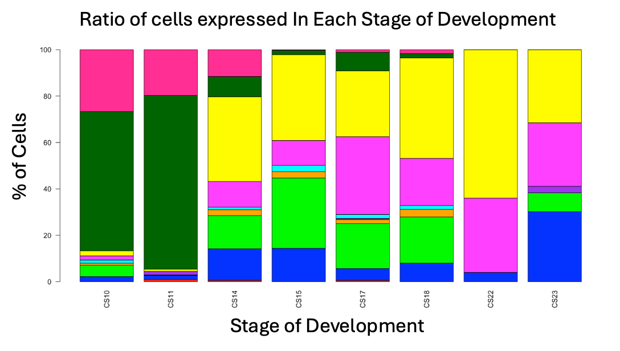
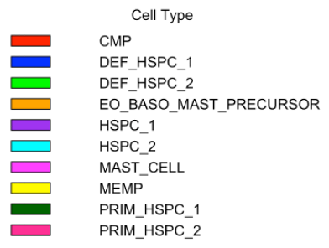
Distribution of Cell Types in Yolk Sac Data Based on Carnegie Stage

Slide 23
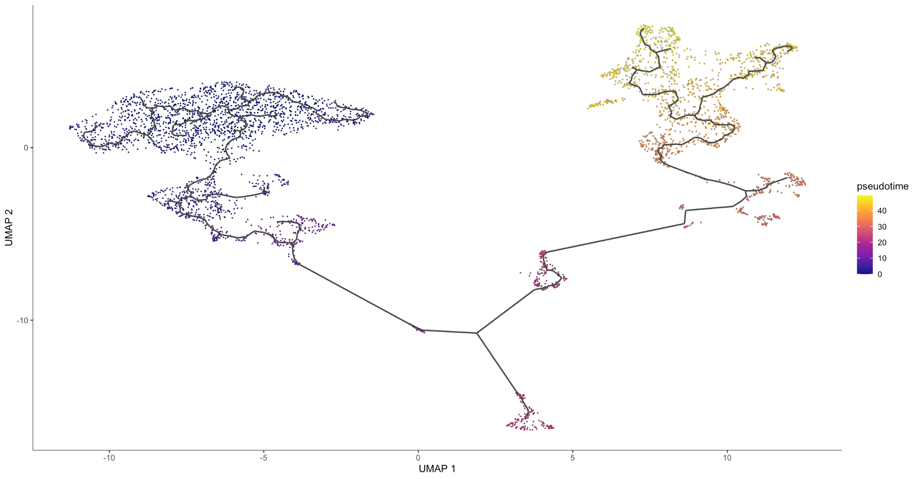
Does Pseudotime Trajectory Analysis Model Hematopoiesis?

Slide 24
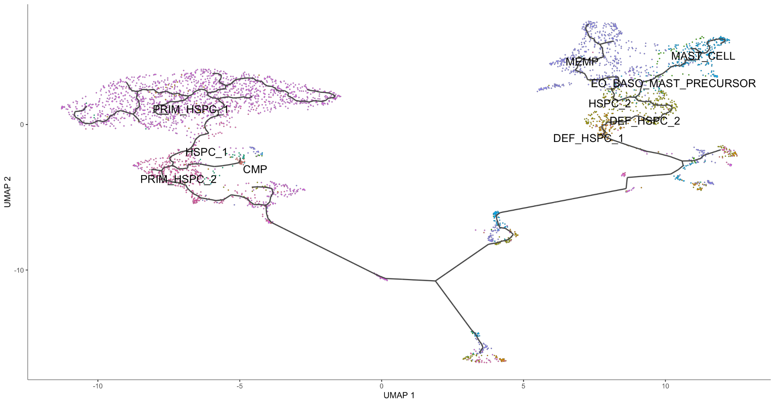
Does Pseudotime Trajectory Is Able to Capture Expected Mast Differentiation Pathway

Slide 25
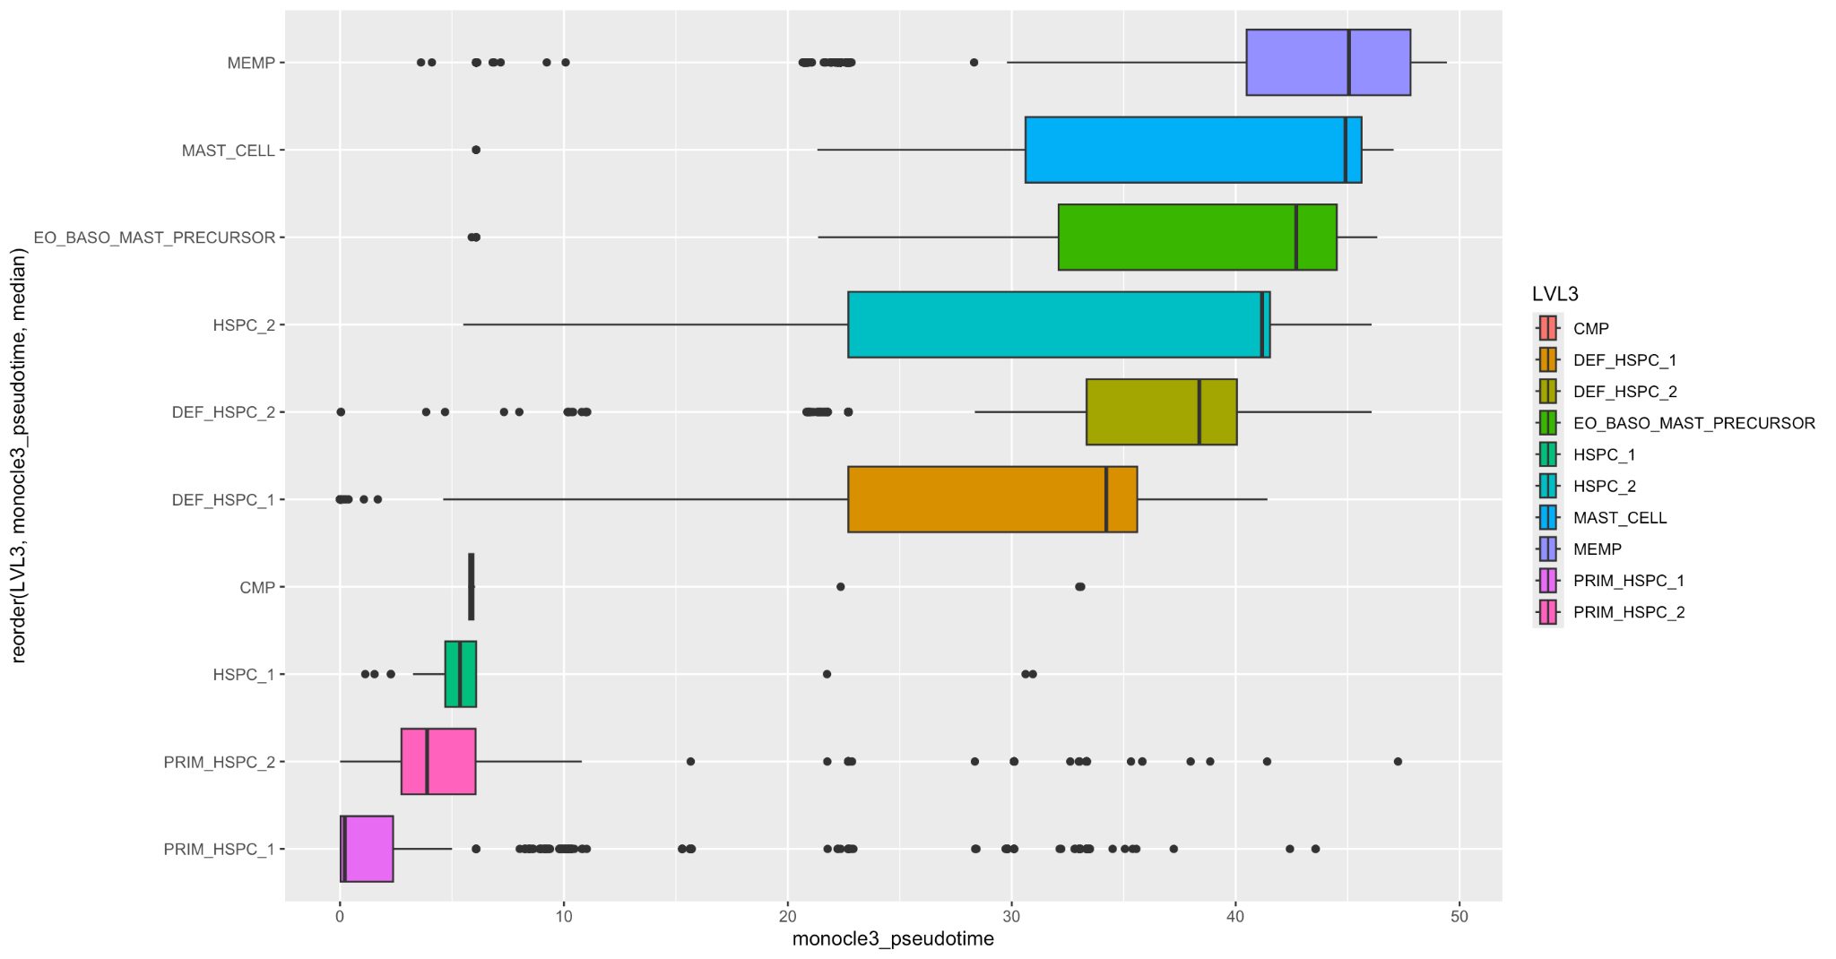
Cells Within Yolk Sac Data Follow Expected Trends in Pseudotime Analysis

Slide 26
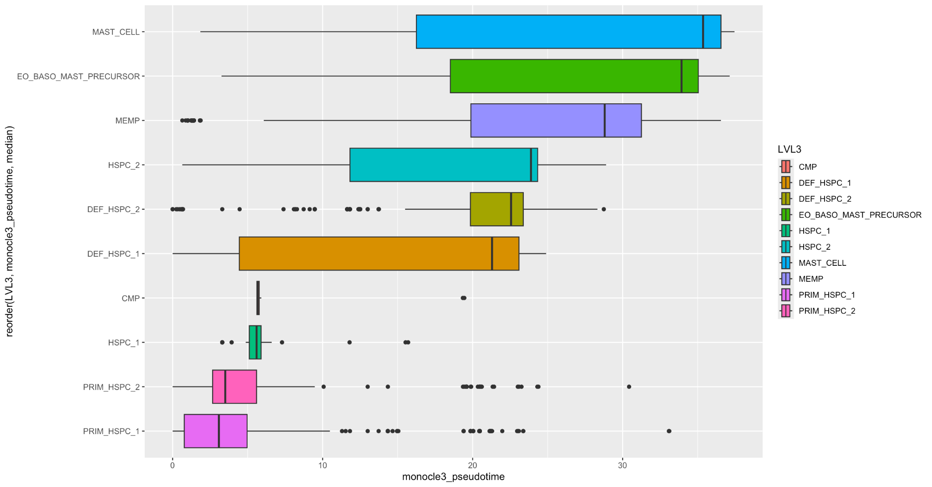
Cells Within Yolk Sac Data Follow Expected Trends in Pesudotime Analysis

Slide 27
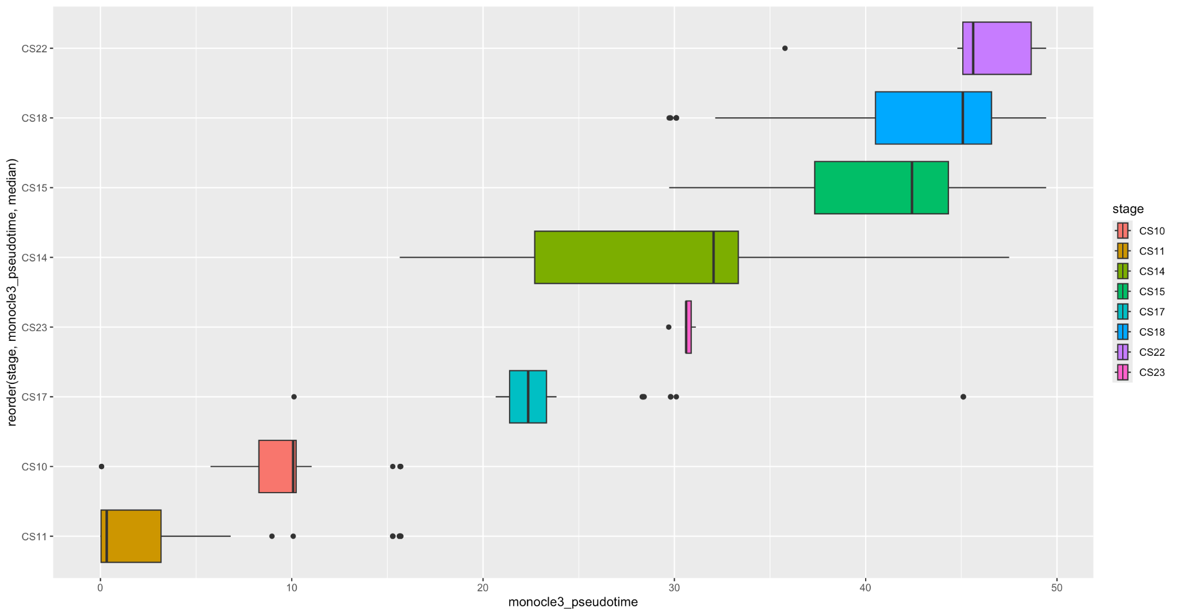
Samples Separate in Pseudotime Based on Carnegie Stage of Development But Do Not Completely Follow A Trend Based On Age

Slide 28
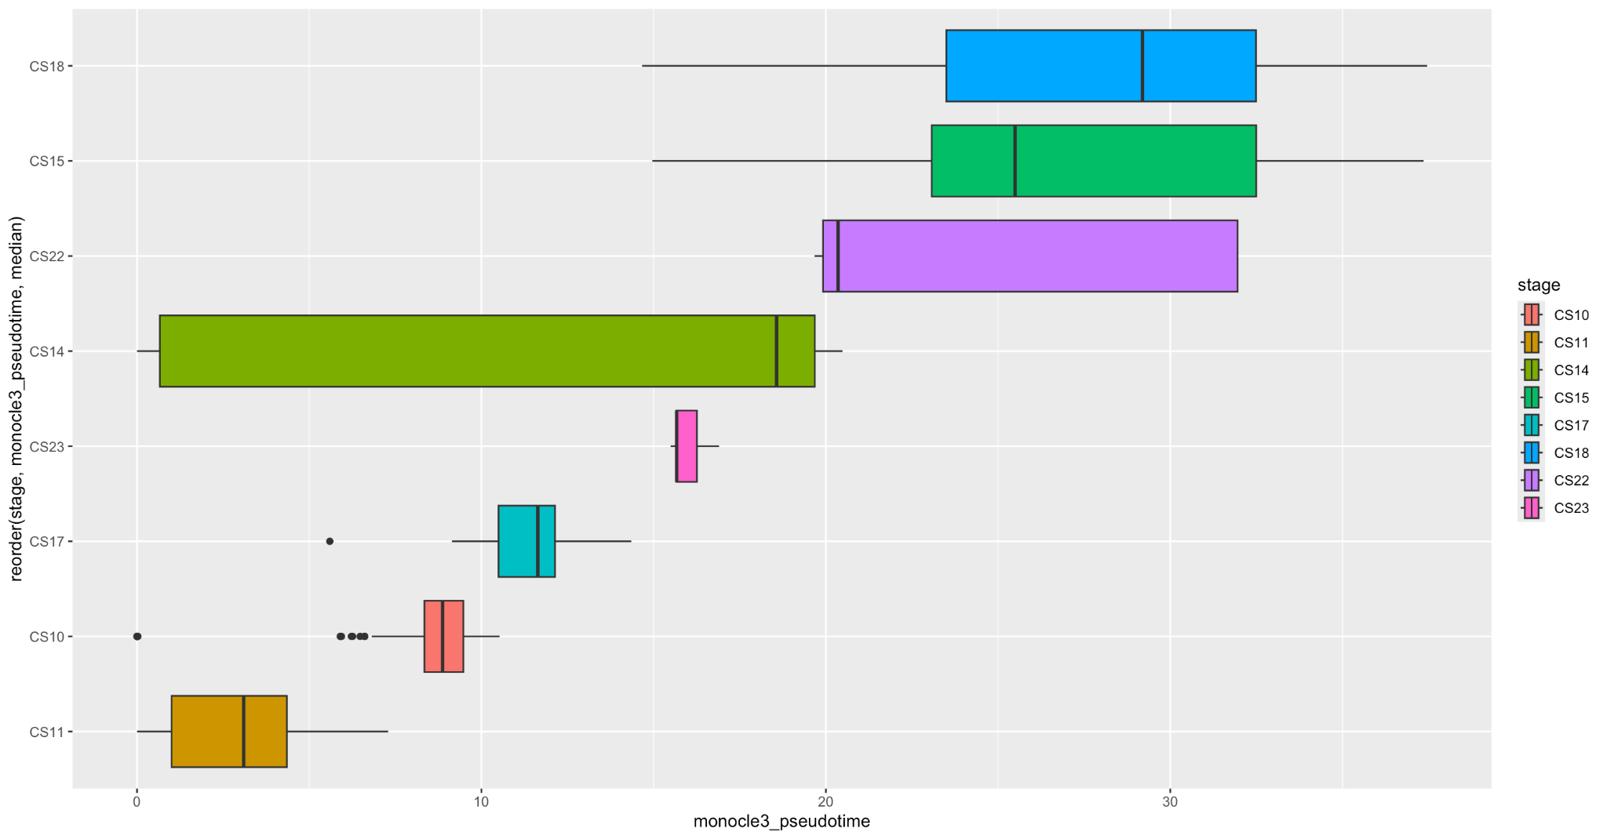
Samples separate in Pesudotime Based on Carnegie Stage of Development: But Do Not Completely Follow A Trend Based On Age

Slide 29
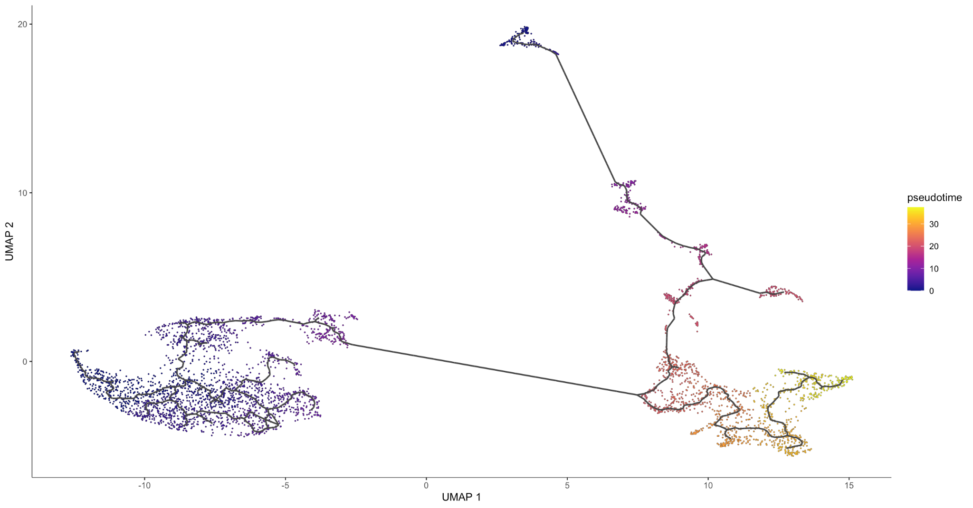
Does Pseudotime Trajectory Analysis Model Hematopoiesis?

Slide 30
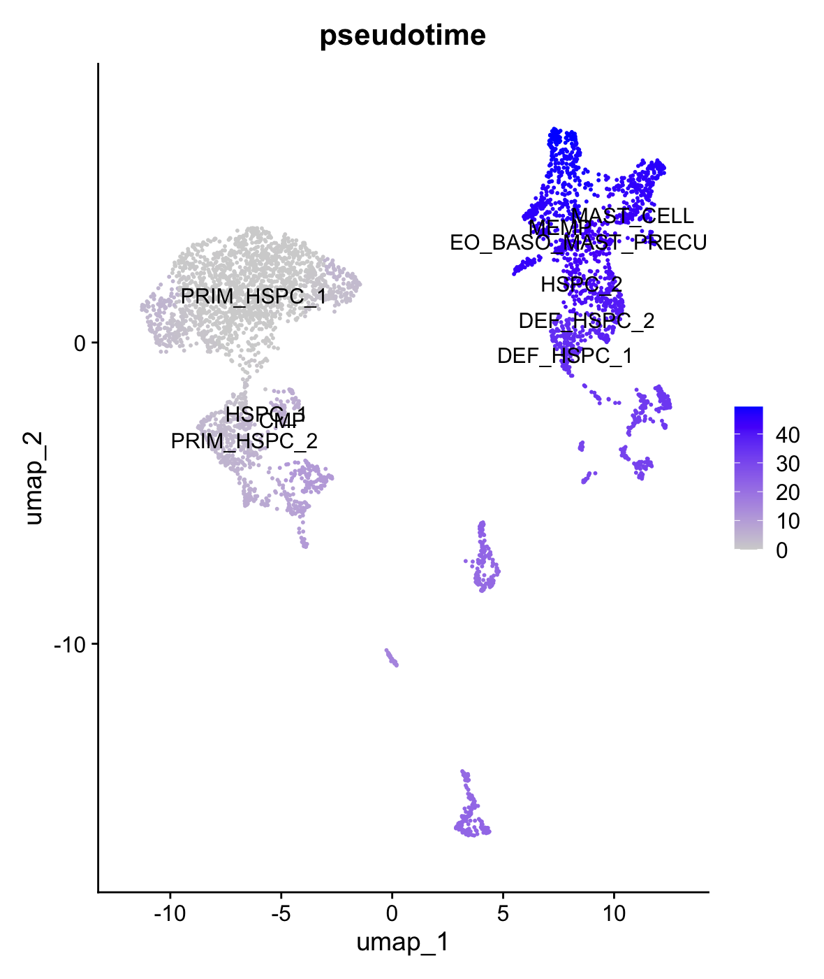
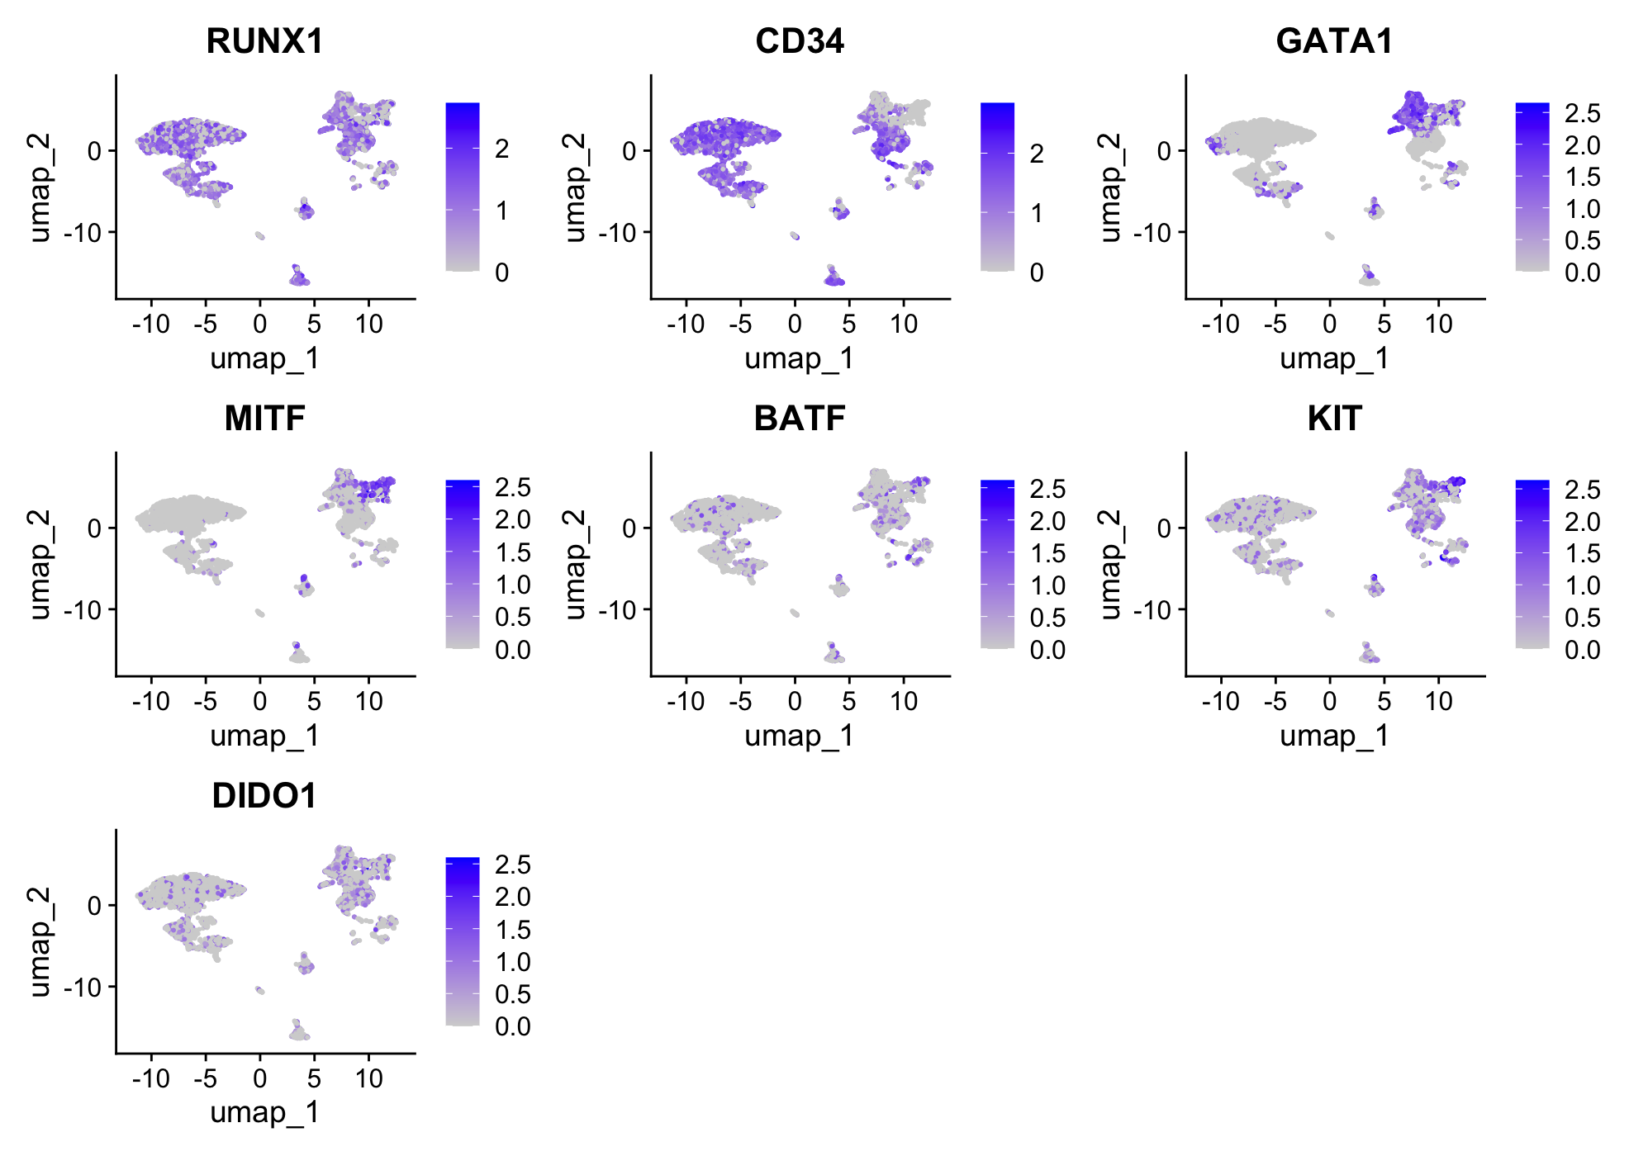
Pseudotime Trajectory of Yolk Sac Data Follows Expected Trajectory

Slide 31
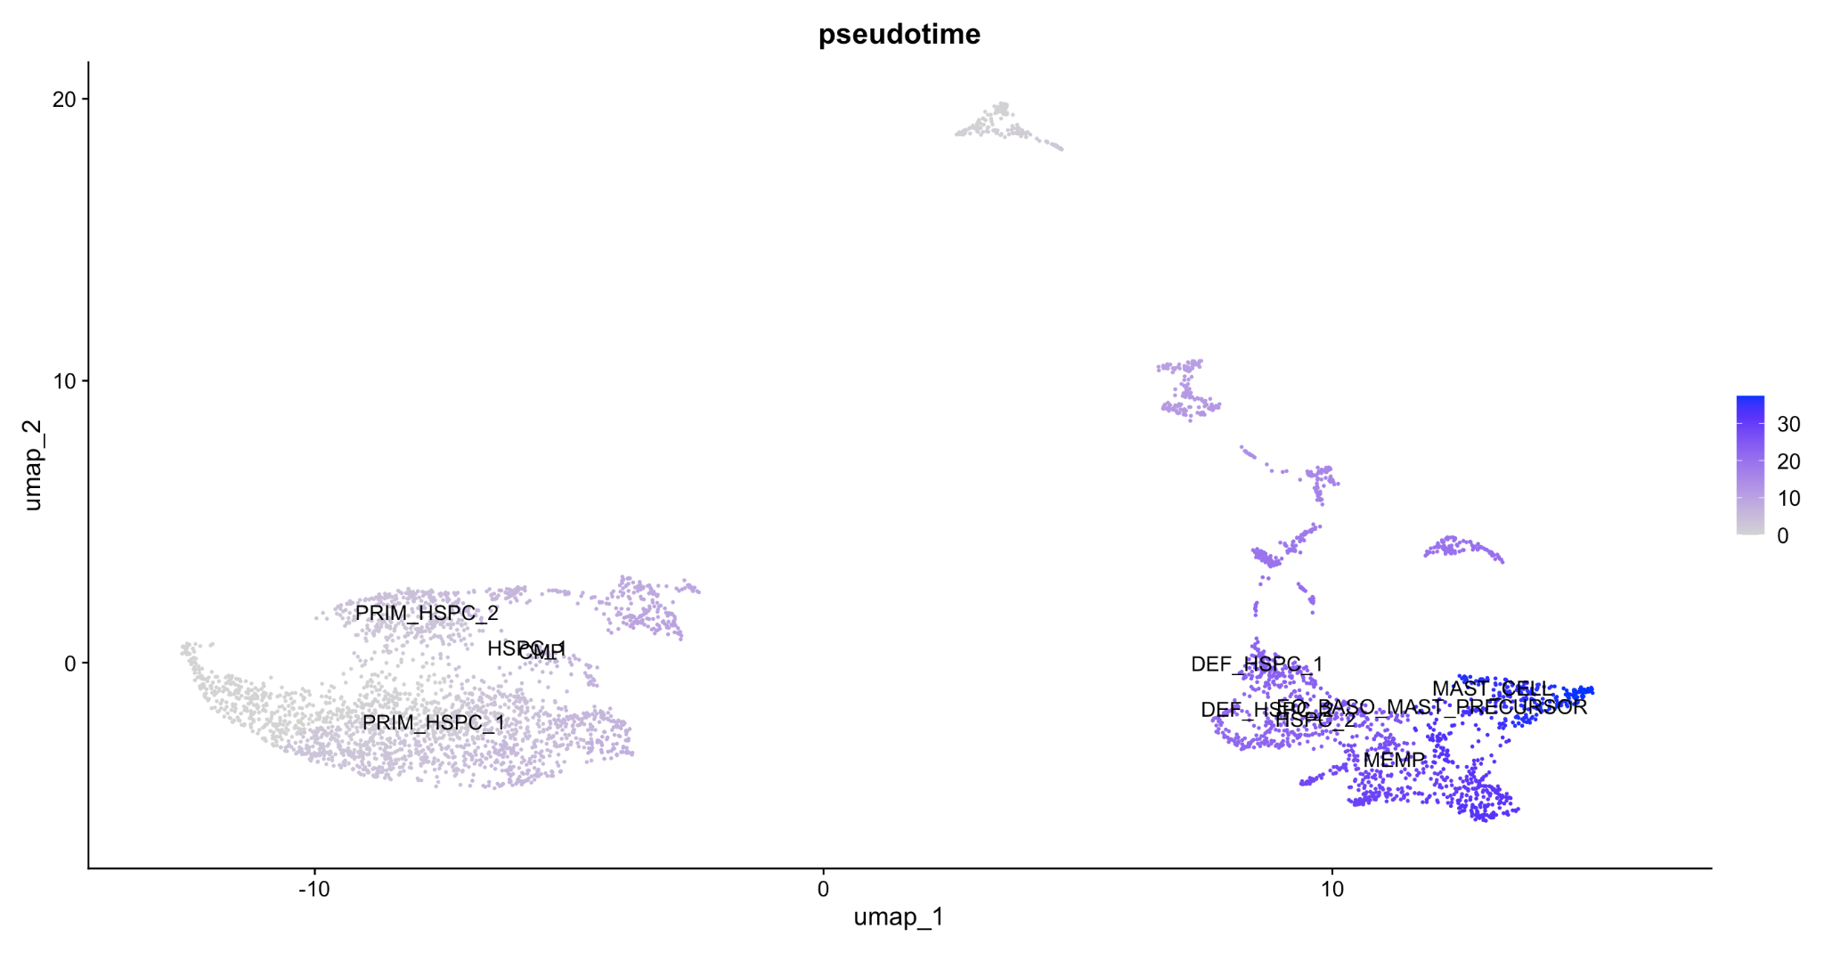
Pseudotime Trajectory of Yolk Sac Data Follows Expected Trajectory

Slide 32
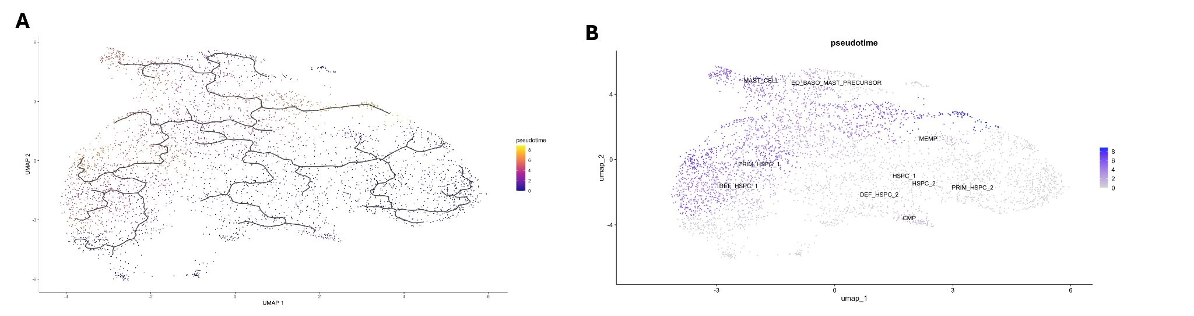
Interesting Finding: Seurat Anchors Clustering give a much different output.
Notes:
Take out IL3,
Keep: MITF, KIT, CD34, RUNX1, CDH7, DIDO1

Slide 33
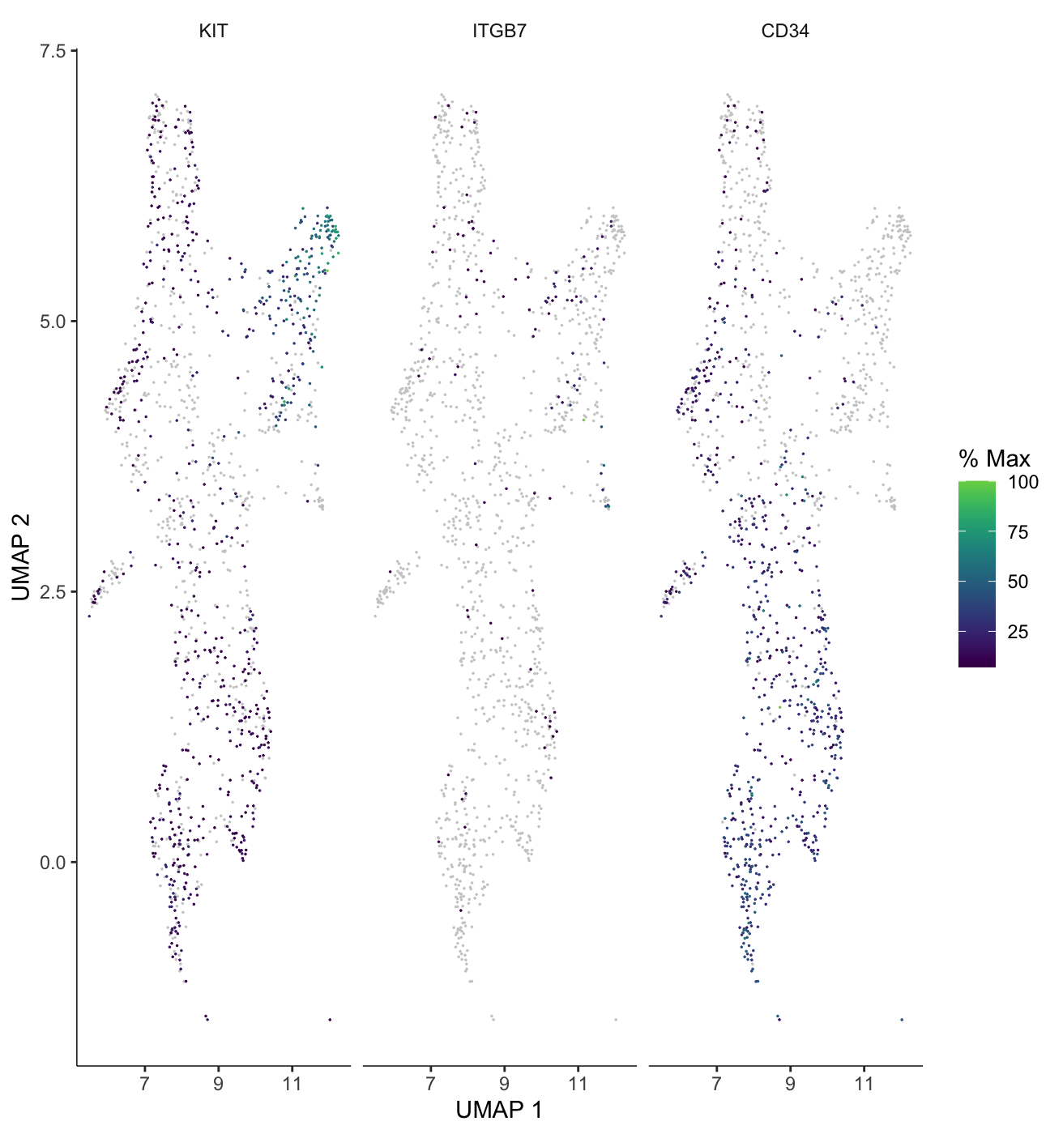
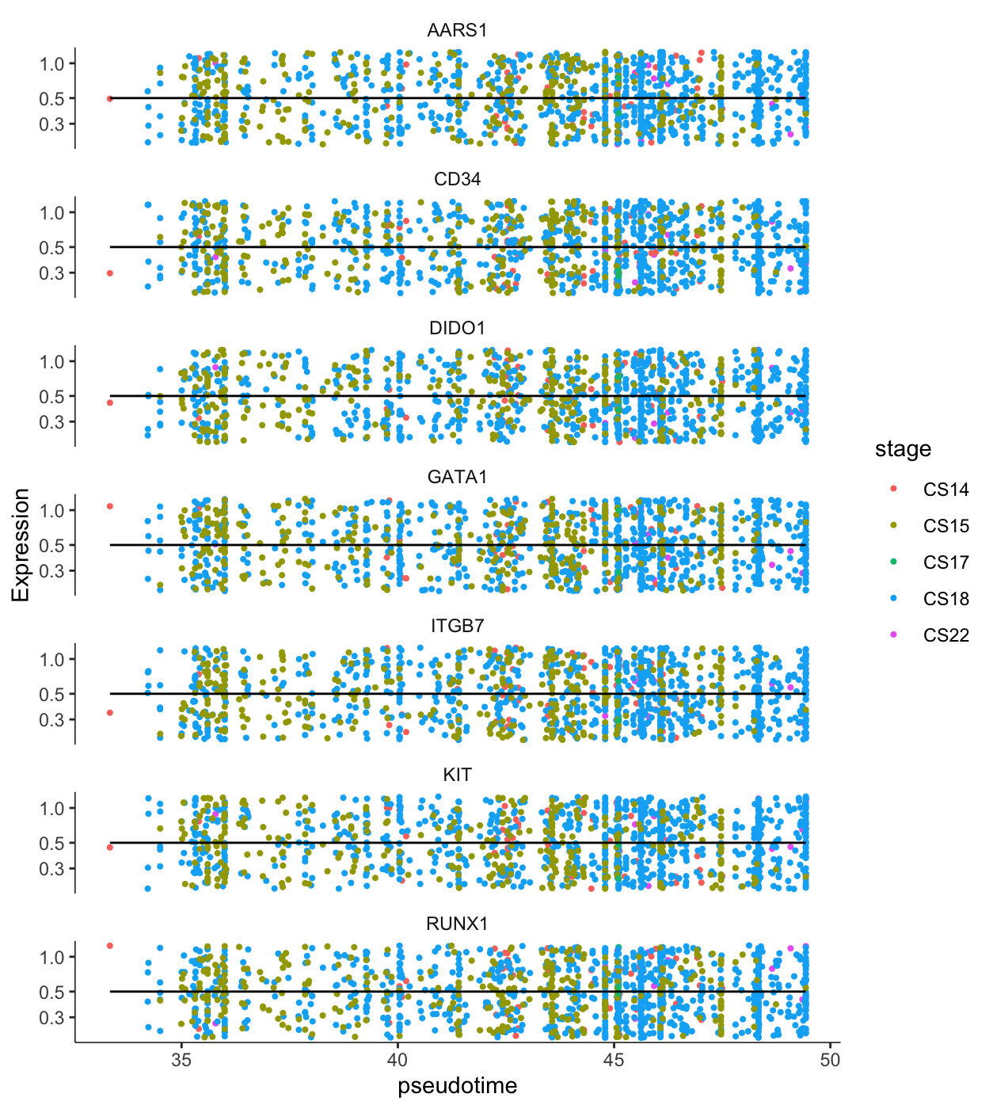
Subset of Mast Cells and Progenitors Show No Clear Difference Based on Stage of Development
Notes:
Take out IL3,
Keep: MITF, KIT, CD34, RUNX1, CDH7, DIDO1

Slide 34
Conclusions
Chromatin associated proteins enriched in clusters 1 & 0 (DIDO1, SUPT, BRCA2, etc.)
Might suggest cells annotated as mast cells were progenitors / less differentiated in the embryonic dataset.
We were able to do pseudotime analysis to map hematopoiesis of mast cells.
The more primitive cells did not seem to be closely related to MCs?
If primitive hspcs are connected to MC lineage fate there seems to be an intermediate state that is missing in the pseudotime plot.
Small subsets of two separate data sets
Could have done a whole project on QC!

Slide 35
Thank You! Questions?

